Slide 1
The AI revolution in scientific research
Source: The Royal Society and The Alan Turing Institute Report

Slide 2
From the t-test to the frontiers of AI
Scientists aspire to understand the workings of nature, people, and society by:
Formulating hypotheses,
Designing experiments, and
Collecting data
The aim is analyzing and better understanding natural, physical, and social phenomena
Notes:
In the early 1900s, for example, the development of the t-test gave researchers a new tool to extract insights from data in order to test the veracity of their hypotheses. Such mathematical frameworks were vital in extracting as much information as possible from data that had often taken significant time and money to generate and collect

Slide 3
From the t-test to the frontiers of AI
Data collection and analysis is a core element of the scientific method, and scientists have long used statistical techniques to aid their work
t-test (Student test) gave researchers a new tool to extract insights from data in order to test the veracity of their hypotheses.
Such mathematical frameworks were vital in extracting as much information as possible from data that had often taken significant time and money to generate and collect
Notes:
In the early 1900s, for example, the development of the t-test gave researchers a new tool to extract insights from data in order to test the veracity of their hypotheses. Such mathematical frameworks were vital in extracting as much information as possible from data that had often taken significant time and money to generate and collect

Slide 4
From the t-test to the frontiers of AI
The application of statistical methods to scientific challenges can be seen throughout history:
The analysis by Johannes Kepler of the astronomic measurements of Tycho Brahe in the early seventeenth century led to his formulation of the laws of planetary motion, which subsequently enabled Isaac Newton (and others) to formulate the law of universal gravitation.

Slide 5
From the t-test to the frontiers of AI
The application of statistical methods to scientific challenges can be seen throughout history:
The laboratory at Rothamsted was established as a centre for agricultural research, running continuously monitored experiments from 1856 which are still running to this day. Ronald Fisher – a prominent statistician – was hired to work there in 1919 to direct analysis of these experiments. His work went on to develop the theory of experimental design and lay the groundwork for many fundamental statistical methods that are still in use today.

Slide 6
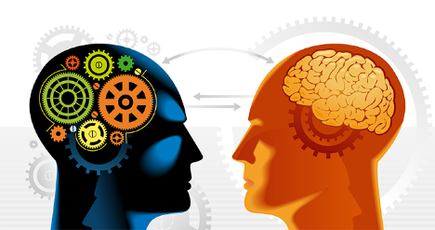
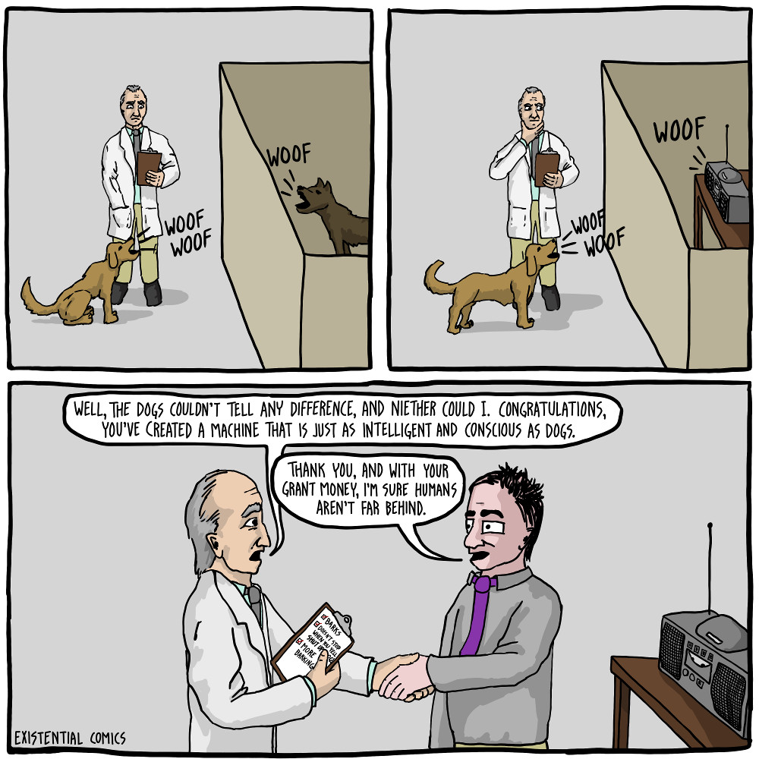
From the t-test to the frontiers of AI
The development of artificial intelligence (AI) techniques offered additional tools for extracting insights from data.
Alan Turing grappled with the idea of machine intelligence.
In 1950, he posed the question “can machines think?”, and suggested a test for machine intelligence – subsequently known as the Turing Test – in which a machine might be called intelligent, if its responses to questions could convince a person that it was human

Slide 7
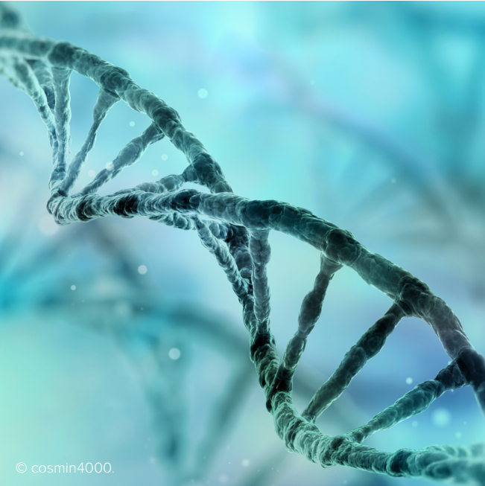
AI as an enabler of scientific discovery
Using genomic data to predict protein structures:
By predicting the protein’s shape, scientists can identify proteins that play a role in diseases, improving diagnosis and helping develop new treatments.
Determining the shape of a protein from its corresponding genetic sequence – the protein-folding challenge – is a complex task.
The AlphaFold project at DeepMind has created a deep neural network that predicts the distances between pairs of amino acids and the angles between their bonds, and in so doing produces a highly-accurate prediction of an overall protein structure.
Notes:
Using genomic data to predict protein structures:
Understanding a protein’s shape is key to understanding
the role it plays in the body. By predicting these shapes,
scientists can identify proteins that play a role in
diseases, improving diagnosis and helping develop new
treatments. The process of determining protein structures
is both technically difficult and labour-intensive, yielding
approximately 100,000 known structures to date5. While
advances in genetics in recent decades have provided
rich datasets of DNA sequences, determining the shape
of a protein from its corresponding genetic sequence –
the protein-folding challenge – is a complex task. To help
understand this process, researchers are developing
machine learning approaches that can predict the threedimensional structure of proteins from DNA sequences.
The AlphaFold project at DeepMind, for example, has
created a deep neural network that predicts the distances
between pairs of amino acids and the angles between
their bonds, and in so doing produces a highly-accurate
prediction of an overall protein structure6.

Slide 8
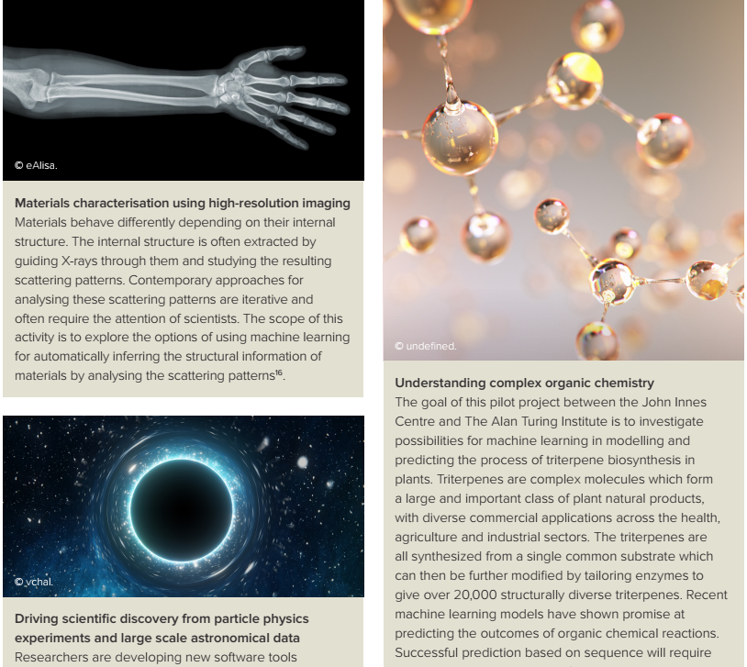
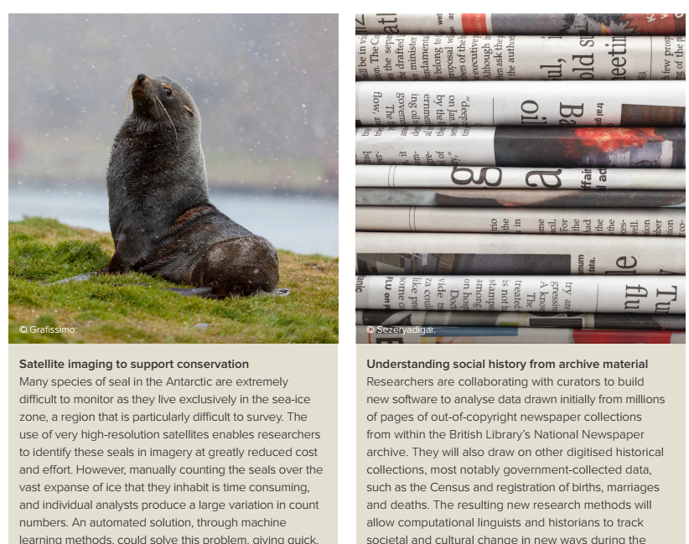
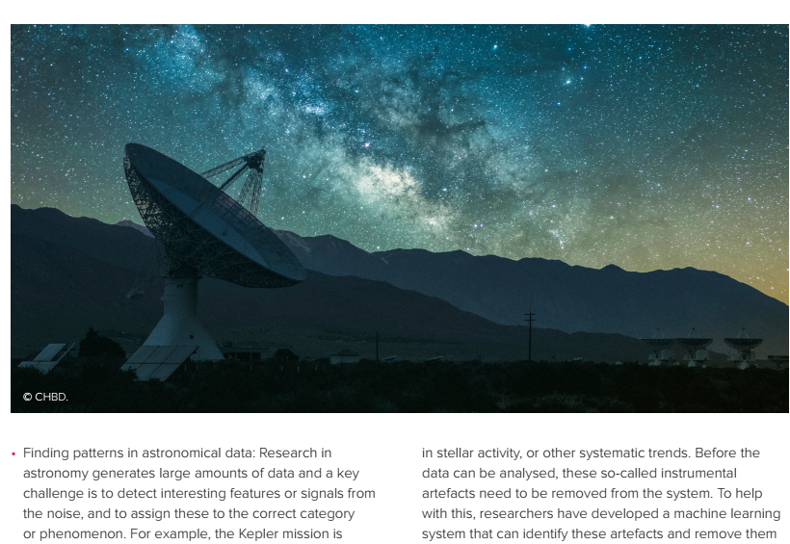
AI as an enabler of scientific discovery
Notes:
Using genomic data to predict protein structures:
Understanding a protein’s shape is key to understanding
the role it plays in the body. By predicting these shapes,
scientists can identify proteins that play a role in
diseases, improving diagnosis and helping develop new
treatments. The process of determining protein structures
is both technically difficult and labour-intensive, yielding
approximately 100,000 known structures to date5. While
advances in genetics in recent decades have provided
rich datasets of DNA sequences, determining the shape
of a protein from its corresponding genetic sequence –
the protein-folding challenge – is a complex task. To help
understand this process, researchers are developing
machine learning approaches that can predict the threedimensional structure of proteins from DNA sequences.
The AlphaFold project at DeepMind, for example, has
created a deep neural network that predicts the distances
between pairs of amino acids and the angles between
their bonds, and in so doing produces a highly-accurate
prediction of an overall protein structure6.

Slide 9
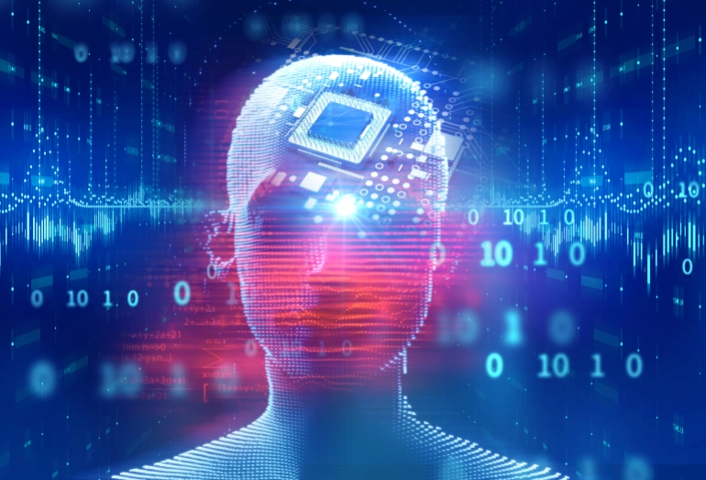

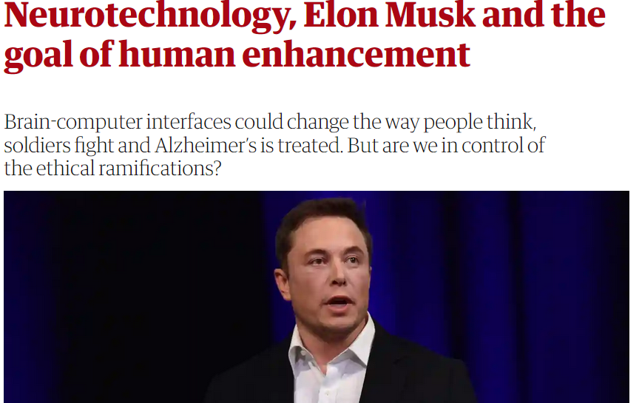

Are things going to get better or worse?
Immersive experience
Next life: Metaverse
Neuralink
Notes:
https://www.intel.com/content/www/us/en/newsroom/opinion/powering-metaverse.html#gs.j1smc2
https://www.aljazeera.net/news/scienceandtechnology/2021/12/18/%D8%A8%D8%B9%D8%B6-%D8%A7%D9%84%D8%AA%D9%82%D9%86%D9%8A%D8%A7%D8%AA-%D8%A7%D9%84%D8%AA%D9%8A-%D8%AA%D8%B9%D9%85%D9%84-%D8%B9%D9%84%D9%8A%D9%87%D8%A7-%D8%A5%D9%86%D8%AA%D9%84
https://thebulletin.org/2020/04/neurotechnology-overview-why-we-need-a-treaty-to-regulate-weapons-controlled-by-thinking/
https://www.theguardian.com/technology/2018/jan/01/elon-musk-neurotechnology-human-enhancement-brain-computer-interfaces

Slide 10
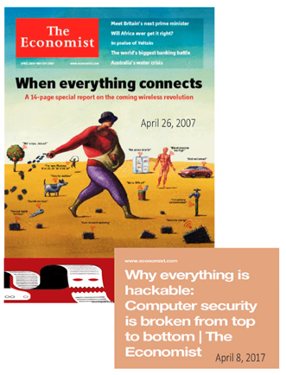
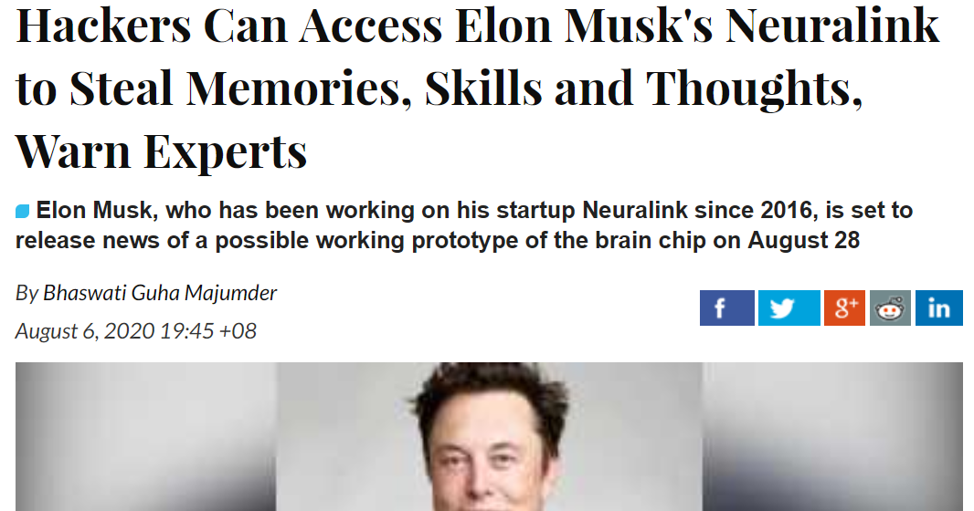
Are things going to get better or worse?
Smart Environment could become horror environment unless we design security (and privacy) correctly
Notes:
https://thebulletin.org/2020/04/neurotechnology-overview-why-we-need-a-treaty-to-regulate-weapons-controlled-by-thinking/
https://www.theguardian.com/technology/2018/jan/01/elon-musk-neurotechnology-human-enhancement-brain-computer-interfaces

Slide 11
Research questions to advance the application of AI in science
Let start with the Human Brain: Information processing
AI Hypothesis: the human brain as a biological computer System
Store the information
Process and analyze the information using complex algorithms

Slide 12
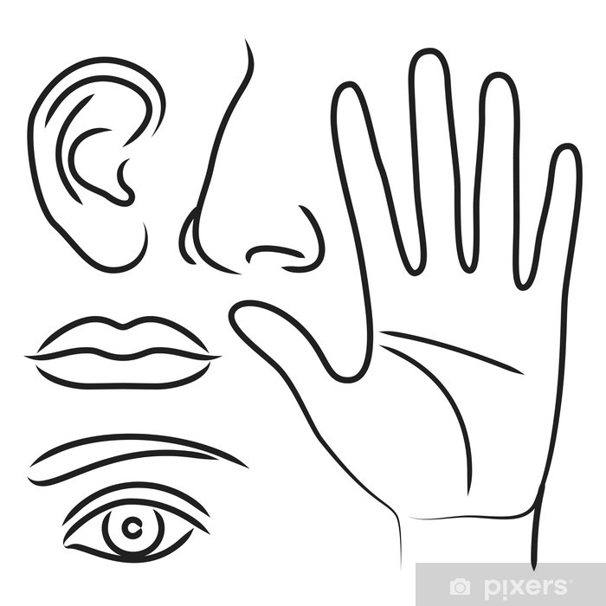
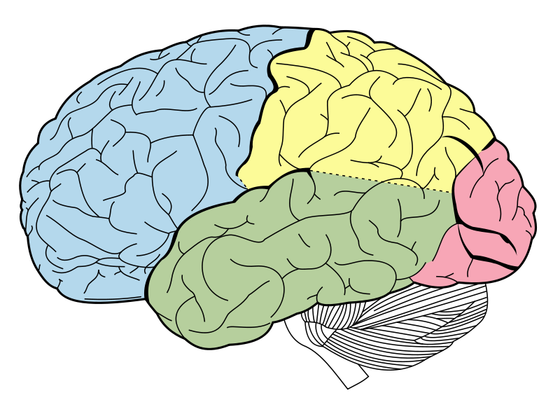
Research questions to advance the application of AI in science
Let start with the Human Brain: Information processing
Store, process and analyse data
Raw data
Information/
Decision

Slide 13
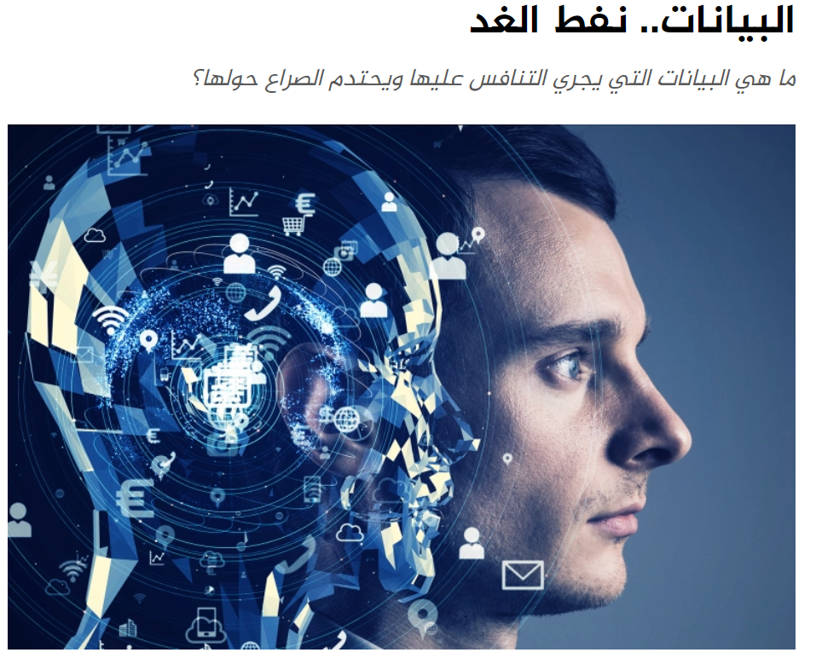
Research questions to advance the application of AI in science
DATA is important

Slide 14
Research questions to advance the application of AI in science
DATA MANAGEMENT
Is there a principled method to decide what data to keep and what to discard, when an experiment or observation produces too much data to store? How will this affect the ability to re-use the data to test alternative theories to the one that informed the filtering decision?

Slide 15
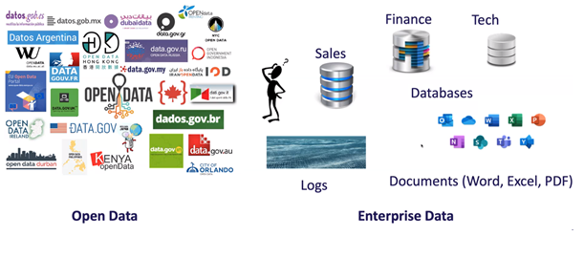
Research questions to advance the application of AI in science
DATA MANAGEMENT
What does ‘open data’ mean in practice where the data sets are just too large, complex and heterogenous for anyone to actually access and understand them in their entirety

Slide 16
Research questions to advance the application of AI in science
DATA MANAGEMENT
How can scientists search efficiently for rare or unusual events and objects in large and noisy data sets?

Slide 17
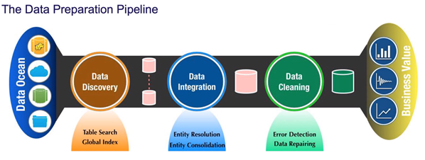
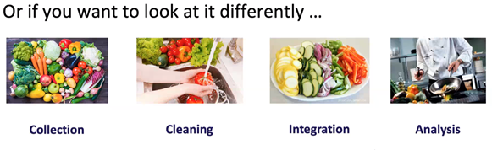
Research questions to advance the application of AI in science
DATA MANAGEMENT

Slide 18
Research questions to advance the application of AI in science
AI METHODS AND CAPABILITIES
How can machine learning help integrate data from different sources collected under different conditions and for different purposes, in a way that is scientifically valid (for example, integrate observations of the same system taken at different scales)

Slide 19
Research questions to advance the application of AI in science
AI METHODS AND CAPABILITIES
How can researchers re-use data which they have already used to inform theory development, while maintaining the rigour of their work

Slide 20
Research questions to advance the application of AI in science
AI METHODS AND CAPABILITIES
How can AI methods produce results which are transparent as to how they were obtained, and interpretable within the disciplinary context

Slide 21
Research questions to advance the application of AI in science
AI METHODS AND CAPABILITIES
How can research help create more advanced, and more accurate, methods of verifying machine learning systems to increase confidence in their deployment

Slide 22
Research questions to advance the application of AI in science
INTEGRATING SCIENTIFIC KNOWLEDGE
Is there a rigorous way to incorporate existing theory/ knowledge into a machine learning algorithm, to constrain the outcomes to scientifically plausible solutions?
How can AI be used to actually discover and create new scientific knowledge and understanding, and not just the classification and detection of statistical patterns?

Slide 23

What is Artificial Intelligence?

Slide 24
What is Artificial Intelligence?
The expression ‘artificial intelligence’ today is therefore an umbrella term.
It refers to a suite of technologies that can perform complex tasks when acting in conditions of uncertainty, including visual perception, speech recognition, natural language processing, reasoning, learning from data, and a range of optimization problems

Slide 25
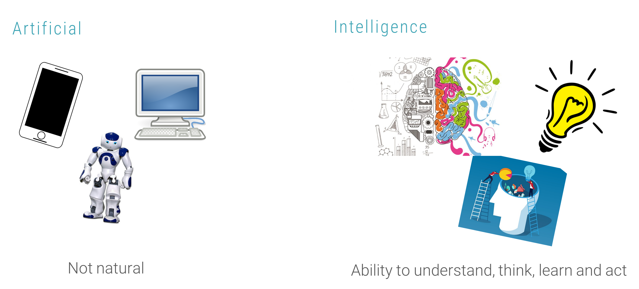
What is Artificial Intelligence?

Slide 26
What is Artificial Intelligence?
Artificial Intelligence (AI)
Artificial intelligence (AI) is intelligence demonstrated by machines, as opposed to natural intelligence displayed by animals including humans.
Leading AI textbooks define the field as the study of "intelligent agents": any system that perceives its environment and takes actions that maximize its chance of achieving its goals.
Some popular accounts use the term "artificial intelligence" to describe machines that mimic "cognitive" functions that humans associate with the human mind, such as "learning" and "problem solving", however, this definition is rejected by major AI researchers.

Slide 27
What is Artificial Intelligence?
Artificial General Intelligence (AGI)
AGI is the hypothetical ability of an intelligent agent to understand or learn any intellectual task that a human being can.
It is a primary goal of some artificial intelligence research and a common topic in science fiction and futures studies.
AGI can also be referred to as strong AI, full AI, or general intelligent action. (Although academic sources reserve the term "strong AI" for computer programs that experience sentience or consciousness.)

Slide 28
What is Artificial Intelligence?
Indivudual Artificial Intelligence: neurocomputer interface
Completely new type of artificial intelligence: technological symbiosis against traditional electronic systems
Biotechnological neurocomputer symbiosis
Human brain and a machine will work together in a dual complementary system
Both components will complement and reinforce each other
Notes:
https://thenextweb.com/news/what-ai-could-be-like-when-you-plug-a-computer-into-your-brain-syndication

Slide 29
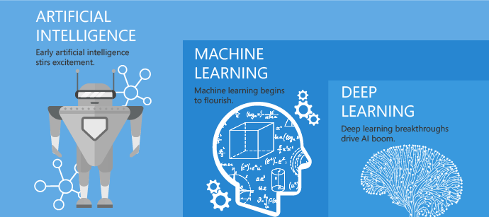
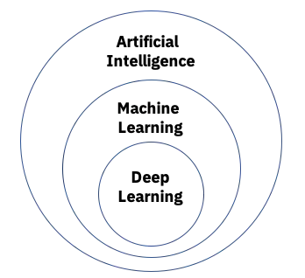
Artificial Intelligence
It’s not the destination, it's the journey

Slide 30
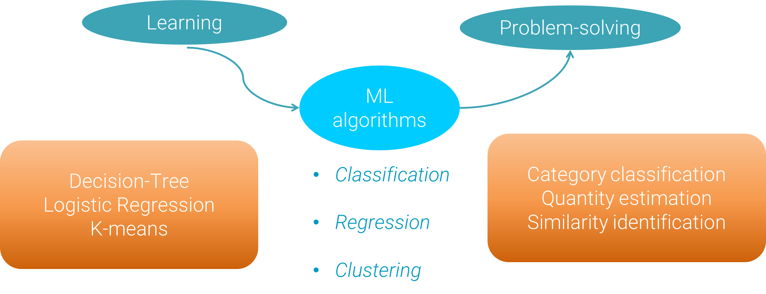
Artificial Intelligence
Machine Learning (ML)
Is a method of achieving AI by using algorithms enabling machines to learn from data how to make decisions.

Slide 31
Data preparation problem
The Problem with Data Science
Most organizations still face a data scientist bottleneck.
People want to do data science, they want to use machine learning models in production, but they can’t achieve this because they don’t have the required resources.
While colleges and others try to create as many data scientists as possible, it’s just not happening fast enough and it’s hard to hire them.
The potential solution comes with two different flavors
The first flavor – let’s empower more people to do the work data scientists do. So, that means we need to make this a little bit simpler because data science, in general, and machine learning is just too hard. If data preparation is such an important part of data science, we need to make that simpler as well.
The other flavor – let’s make sure that the resources we currently have, or we are going to hire in the future, are more productive.
So now, how does data preparation play an important role here?
Notes:
https://rapidminer.com/blog/data-prep-time-consuming-tedious/

Slide 32
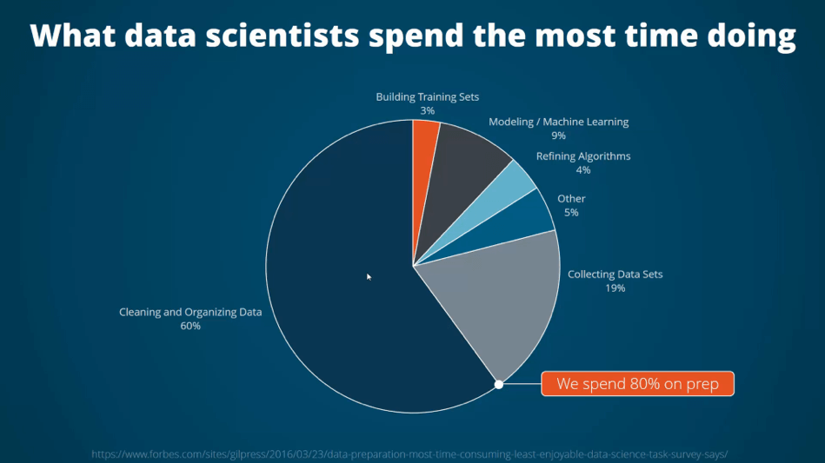
Data preparation problem
What do data scientists spend the most time doing?
We all keep saying that 80% of our work as machine learning experts and data scientists is preparing the data.
So, we spend more than 80% on data preparation. That’s probably because we love it so much, right? Wrong.
Notes:
https://rapidminer.com/blog/data-prep-time-consuming-tedious/

Slide 33
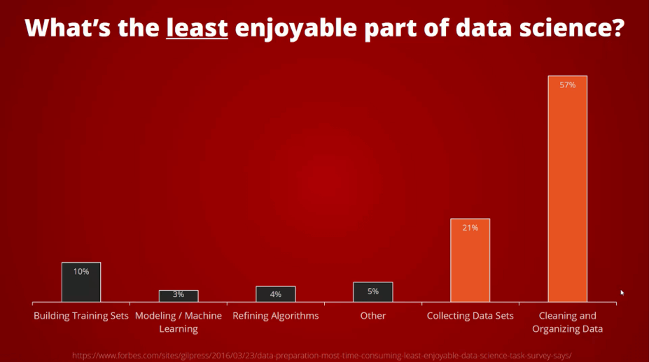
Data preparation problem
What’s the least enjoyable part of data science?
we spend 80% of our time there, and we don’t even enjoy it that much. I mean, that’s horrible, but it’s reality.
57% said it’s cleaning and organizing data
Notes:
https://rapidminer.com/blog/data-prep-time-consuming-tedious/

Slide 34
Data preparation problem
Why data preparation is so important?
Data preparation is a multi-step process that involves data collection, cleaning & preprocessing, feature engineering, and labeling. These steps play an important role in the overall quality of your machine learning model, as they build on each other to ensure a model performs to expectations.
Notes:
https://rapidminer.com/blog/data-prep-time-consuming-tedious/

Slide 35
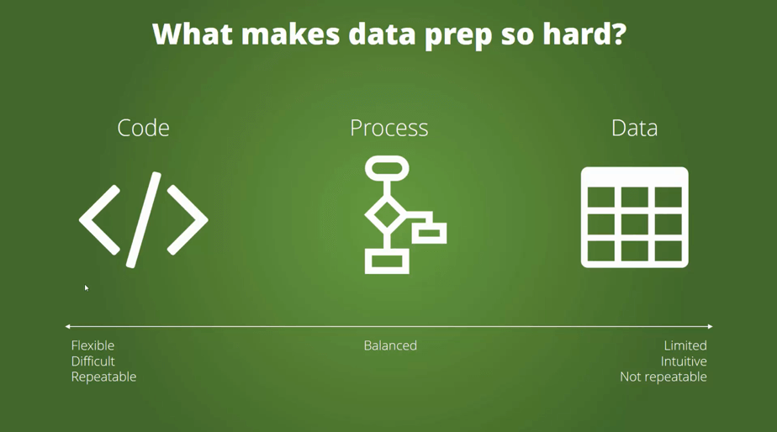
Data preparation problem
What makes data preparation so difficult?
Code-based approach to data science: Python, R
Process-based approach to data science: orange, rapidminer
Data-centric approach to data science: Excel
Notes:
https://rapidminer.com/blog/data-prep-time-consuming-tedious/

Slide 36
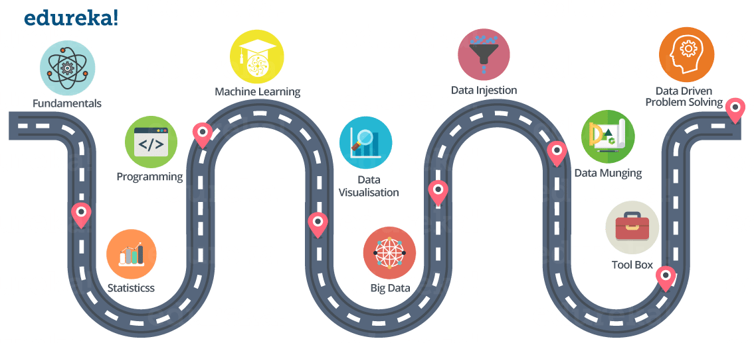
Data preparation problem
The path to be a data scientist
Notes:
https://www.edureka.co/blog/how-to-become-a-data-scientist/
Data munging = Data wrangling, sometimes is the process of transforming and mapping data from one "raw" data form into another format
Data ingestion is the process of obtaining and importing data for immediate use or storage in a database.
Fundamentals: Matrices and Linear Algebra Functions, Reporting VS BI (Business Intelligence) VS Analytics
Statistics: Descriptive Statistics (Mean, Median, Range, Standard Deviation, Variance), Exploratory Data Analysis
Percentiles and Outliers, Probability Theory, Bayes Theorem, Random Variables, Cumulative Distribution function (CDF), Skewness
Other Statistics fundamentals
Programming:
Machine Learning and Advanced Machine Learning (Deep Learning):
Data Visualization: kibana
Big Data: spark
Data Ingestion: The process of importing , transferring , loading and processing data for later use or storage in a database is called Data Ingestion. This involves loading data from a variety of sources. Apache Flume, Apache Sqoop
Data Munging:
If you have ever performed data analysis, you might have come across feature selection before you apply your Analytical model to the data.
So, in general, all the activity that you do on the raw data to make it “clean” enough to input to your analytical algorithm is data munging.
You can use ‘R’ and ‘Python’ packages for that.
Tool Box: You might find this section pretty redundant, but I think it is very very important to have good knowledge on certain tools like:
MS Excel Python or R, Hadoop
Spark, Tableau
Data-Driven Problem Solving:
All the things we have discussed so far, includes tools and technologies that you can learn. But, Data-Driven problem solving approach is something that you need to develop. It will only come with experience.
A Data Scientist needs to know how

